Slide 1

Business Analyst Career Program – Capstone Project
PROJECT TOPIC:
Western countries financial Data
By – Rupali Nand (B.A. Batch 4)

Slide 2
Agenda :
Data Exploration
Statistical Analysis using excel
Graphical Analysis using excel
Insert the given data in sql server
Import the data from the excel to power bi
Interactive Dashboard by using visualization tools
Inferences and Conclusion
End notes

Slide 3
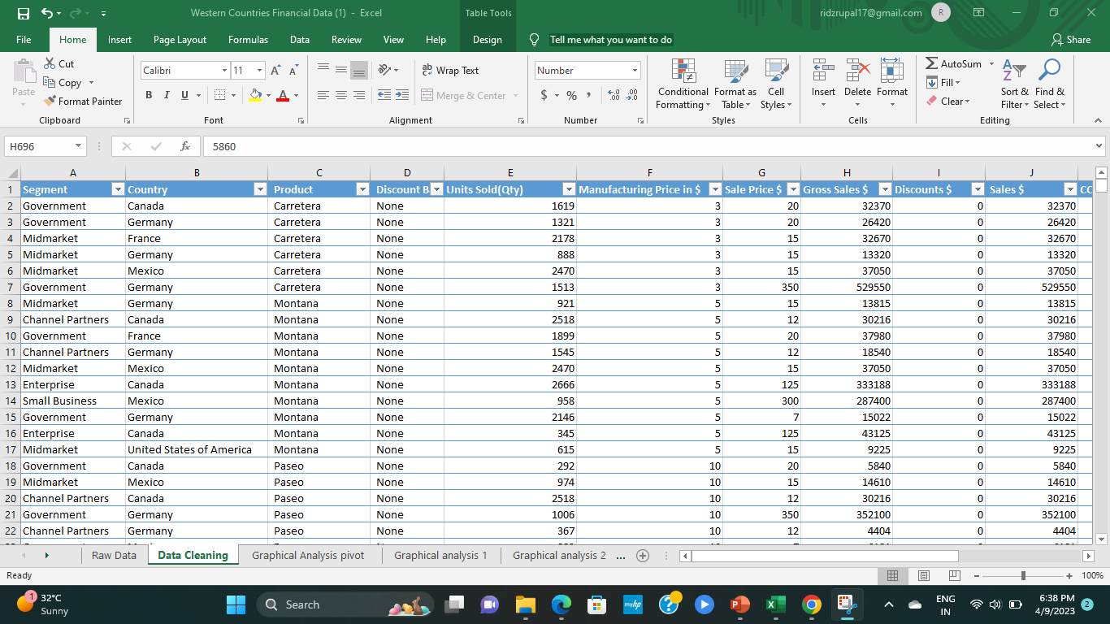
Data Exploration : It is a data of an organization about the sales of premium bicycle brand. This data is crucial in understanding market position, identifying trends ,and making informed business decision This data allows us to track the sales of bicycle brand over time and giving us a clear understanding of bicycle brands popularity and market share.

Slide 4
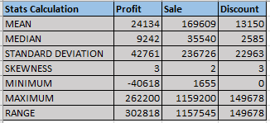
Statistical Analysis using Excel :

Slide 5
Statistical Analysis Graph :

Slide 6
Graphical Analysis using excel : 1- First graph shows the comparison of gross sales by country and segment. 2- Second graph shows the total profit by products.

Slide 7
1- First graph shows total sales across different products and countries. 2- Second graph shows the change in profit and discount percent over time period.

Slide 8
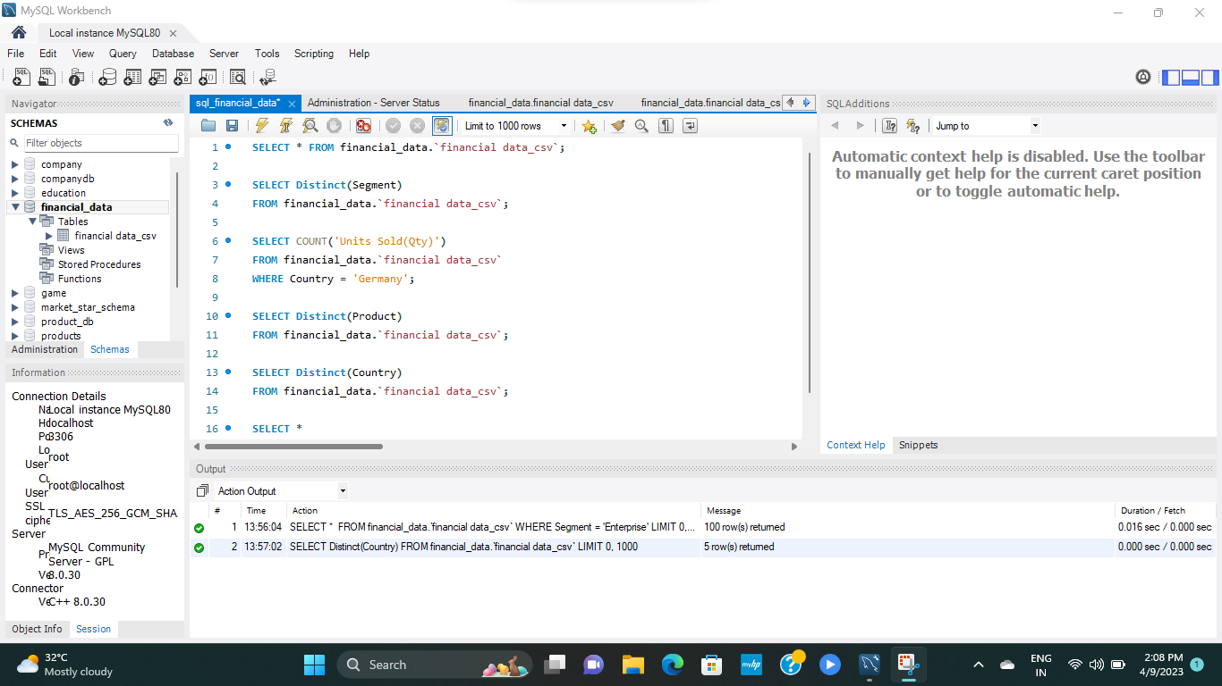
Insert the given data in sql server : Data has successfully inserted into SQL database.

Slide 9
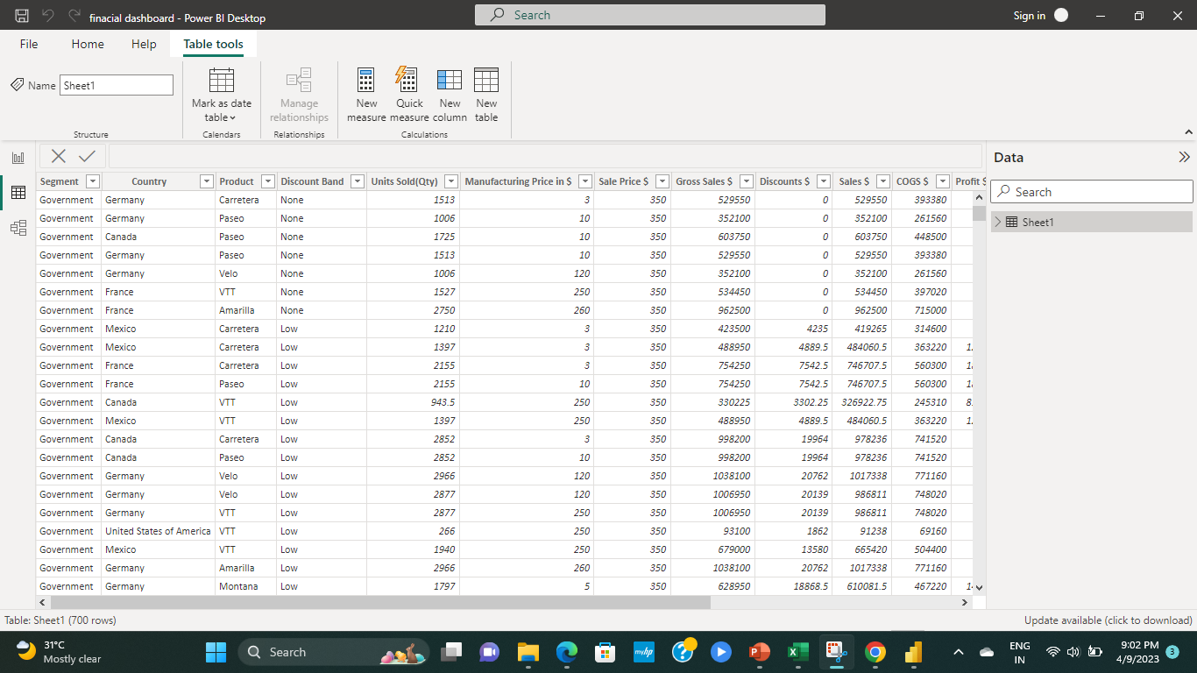
Import the data from the excel to power bi : The financial data has successfully inserted into Power Bi

Slide 10
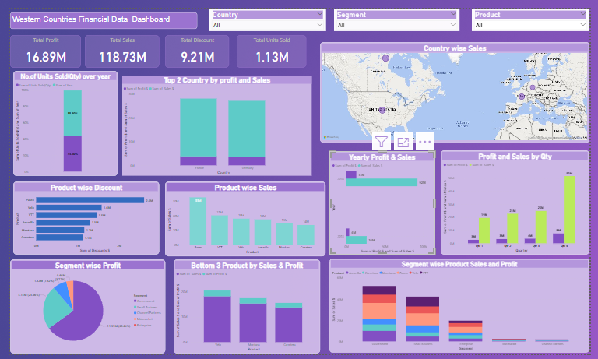
Interactive Dashboard by using visualization tools :

Slide 11
Inferences and Conclusion :
Inferences :
The financial data suggests that the Carretera Premium Bicycle brand is struggling to compete with its competitors in Western countries.
Its poor sales and profitability performance can be attributed to a combination of factors, such as poor marketing strategies, lack of brand awareness, and high competition.
To improve its performance, the brand may need to invest in better marketing and advertising strategies, develop a more competitive pricing strategy, and focus on building brand awareness among its target audience.
Conclusion :
Analyzing financial data of western countries provides valuable insights for business growth. By understanding over all sales trend , market share , consumer behavior we get to know that paseo is the most profitable product for the organization. Organization should focus more on the production of paseo brand bicycle and build more unique features for the best profit in future.

Slide 12
End notes :
Reference link :
https://drive.google.com/file/d/1_xH_g-YEqRcO119ikAhOBqpzvR1zxJt6/view?usp=sharing
https://docs.google.com/spreadsheets/d/1oztNfEpJW6lrbAc27W2qJkS7NWYCjJqB/edit?usp=sharing&ouid=108601016522251852898&rtpof=true&sd=true

